Slide 1
Lecture 13
Exception Handling

Slide 2
Exception Handling-Fundamentals
An exception is an abnormal condition that arises in a code sequence at run time
A Java exception is an object that describes an exceptional condition that has occurred in a piece of code
When an exceptional condition arises, an object representing that exception is created and thrown in the method that caused the error
An exception can be caught to handle it or pass it on
Exceptions can be generated by the Java run-time system, or they can be manually generated by your code
Notes:
https://github.com/fahim-csedu/oop-lab4/blob/main/src/edu/lab/text/SimpleAnalyzer.java

Slide 3
Exception Handling
Performing action in response to exception
Examples
  Exit program (abort)
  Deal with exception and continue
    Print error message
    Request new data
    Retry action

Slide 4
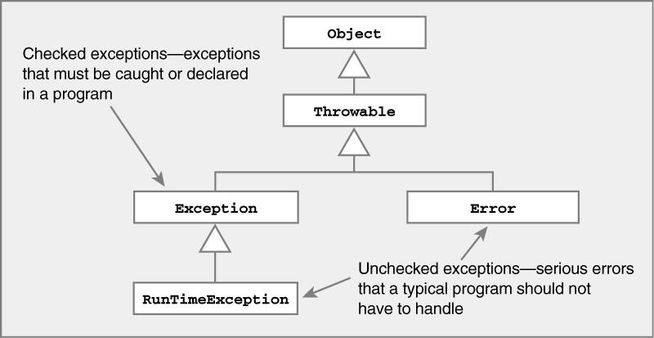
Representing Exceptions

Slide 5
Representing Exceptions
Java Exception class hierarchy
ClassNotFoundException
Exception
CloneNotSupportedException
IOException
ArithmeticException
AWTException
NullPointerException
RuntimeException
Object
Throwable
IndexOutOfBoundsException
…
NoSuchElementException
LinkageError
…
VirtualMachineError
Error
AWTError
Checked
…
Unchecked

Slide 6
Exception Handling in Java
Java exception handling is managed by via five keywords: try, catch, throw, throws, and finally
Program statements to monitor are contained within a try block
If an exception occurs within the try block, it is thrown
Code within catch block catch the exception and handle it

Slide 7
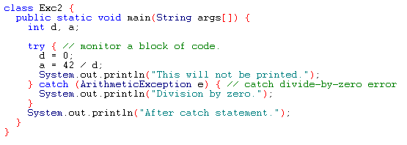
Example
Output:
Division by zero.
After catch statement.

Slide 8
try and catch statement
The scope of a catch clause is restricted to those statements specified by the immediately preceding try statement.
A catch statement cannot catch an exception thrown by another try statement.
The statements that are protected by the try must be surrounded by curly braces.

Slide 9
Multiple Catch Clauses
If more than one can occur, then we use multiple catch clauses
When an exception is thrown, each catch statement is inspected in order, and the first one whose type matches that of the exception is executed
After one catch statement executes, the others are bypassed

Slide 10
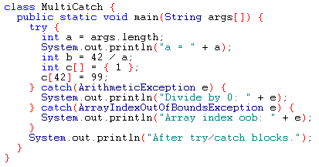
Example

Slide 11
Caution
Exception subclass must come before any of of their superclasses
A catch statement that uses a superclass will catch exceptions of that type plus any of its subclasses. So, the subclass would never be reached if it come after its superclass
For example, ArithmeticException is a subclass of Exception
Moreover, unreachable code in Java generates error

Slide 12
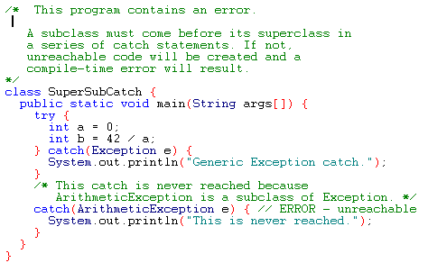
Example

Slide 13
Nested try Statements
A try statement can be inside the block of another try
Each time a try statement is entered, the context of that exception is pushed on the stack
If an inner try statement does not have a catch, then the next try statement’s catch handlers are inspected for a match
If a method call within a try block has try block within it, then then it is still nested try

Slide 14
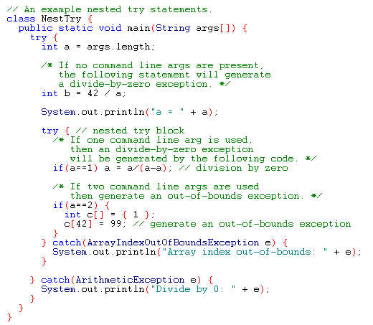
Example

Slide 15
throw
It is possible for your program to to throw an exception explicitly
throw ThrowableInstance
Here, ThrowableInstance must be an object of type Throwable or a subclass Throwable
There are two ways to obtain a Throwable objects:
  Using a parameter into a catch clause
  Creating one with the new operator

Slide 16
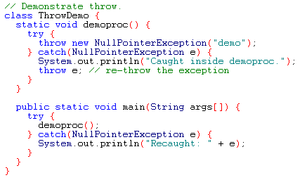
Example -throw Statements
Output:
Caught inside demoproc.
Recaught: java.lang.NullPointerException: demo

Slide 17
throws
If a method is capable of causing an exception that it does not handle, it must specify this behavior so that callers of the method can guard themselves against that exception
type method-name parameter-list) throws exception-list
  {
  // body of method
  }
It is not applicable for Error or RuntimeException, or any of their subclasses

Slide 18
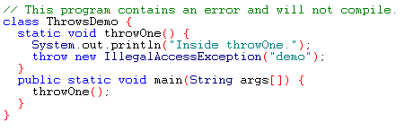
Example: incorrect program

Slide 19
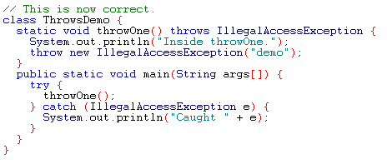
Example: corrected version
Output:
Inside throwOne.
Caught java.lang.IllegalAccessException: demo

Slide 20
Finally Statement
finally creates a block of code that will be executed after a try/catch block has completed and before the code following the try/catch block.
finally block will be executed whether or not an exception is thrown.
Any time a method is about to return to the caller from inside a try/catch block, via an uncaught exception or an explicit return statement, the finally clause is also executed just before the method returns.
Each try clause requires at least one catch or finally clause.

Slide 21
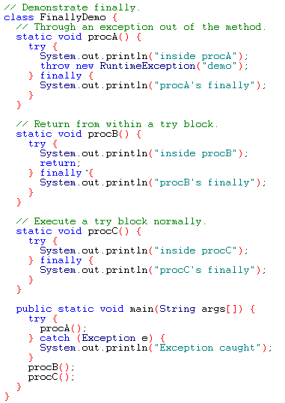
Example

Slide 22
Output
inside procA
procA's finally
Exception caught
inside procB
procB's finally
inside procC
procC's finally

Slide 23
Uncaught Exceptions
class exc0{
public static void main(String args[])
{
int d=0;
int a=42/d;
}
}
A new exception object is constructed and then thrown.
This exception is caught by the default handler provided by the java runtime system.
The default handler displays a string describing the exception, prints the stack trace from the point at which the exception occurred and terminates the program.
Output:
java.lang.ArithmeticException: / by zero
at exc0.main(exc0.java:4)

Slide 24
Displaying a Description of an Exception
Throwable overrides the toString() method (defined by Object) so that it returns a string containing a description of the exception.
Example:
catch(ArithmeticException e)
{
System.out.println(“Exception: “+e);
}
Output:
Exception: java.lang.ArithmeticException: / by zero

Slide 25
User Defined Exception
Define a subclass of the Exception class.
The new subclass inherits all the methods of Exception and can override them.
class MyException extends Exception{
private int a;
MyException(int i) { a = i;}
public String toString (){ return “MyException[“ + a+”]”;}
}

Slide 26
Continuation of the Example
class test{
static void compute (int a) throws Myexception{
if(a>10) throw new MyException(a);
System.out.println(“Normal Exit”);
}
public static void main(String args[]){
try{
compute(1);
compute(20);
}catch(MyException e){ System.out.println(“Caught “ +e);
}
}

Slide 27
Example-2
class InvalidRadiusException extends Exception {
private double r;
public InvalidRadiusException(double radius){
r = radius;
}
public void printError(){
System.out.println("Radius [" + r + "] is not valid");
}
}

Slide 28
Continuation of Example-2
class Circle {
double x, y, r;
public Circle (double centreX, double centreY, double radius ) throws InvalidRadiusException {
if (r <= 0 ) {
throw new InvalidRadiusException(radius);
}
else {
x = centreX ; y = centreY; r = radius;
}
}
}

Slide 29
Continuation of Example-2
class CircleTest {
public static void main(String[] args){
try{
Circle c1 = new Circle(10, 10, -1);
System.out.println("Circle created");
}
catch(InvalidRadiusException e)
{
e.printError();
}
}
}

Slide 30
Chapter 10 of the text book

